Slide 1

Flight Fare Prediction

Slide 2

Our Team
Naik Rohan - 19BCS075
Dhyan M G - 19BCS038
Pranav K M - 19BCS088
B Vijay Kumar - 19BCS017
Nishikant Prasad - 19BCS079

Slide 3

Importing Data
Since data is in form of excel file we have to use pandas read_excel to load the data
After loading it is important to check the complete information of data as it can indication many of the hidden information such as null values in a column or a row
Check whether any null values are there or not. if it is present then following can be done,
Imputing data using Imputation method in sklearn
Filling NaN values with mean, median and mode using fillna() method
Describe data --> which can give statistical analysis

Slide 4

EDA
From description we can see that Date_of_Journey is a object data type, Therefore, we have to convert this datatype into timestamp so as to use this column properly for prediction
For this we require pandas to_datetime to convert object data type to datetime dtype.
dt.day method will extract only day of that date. dt.month method will extract only month of that date

Slide 5

Handling Categorical Data
One can find many ways to handle categorical data. Some of them categorical data are,
Nominal data --> data are not in any order --> OneHotEncoder is used in this case
Ordinal data --> data are in order --> LabelEncoder is used in this case

Slide 6
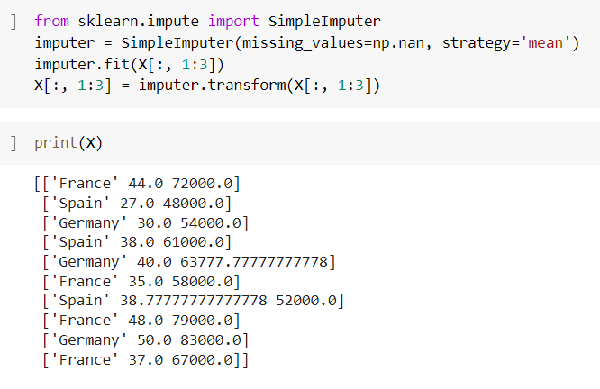
One Hot Encoder

Slide 7
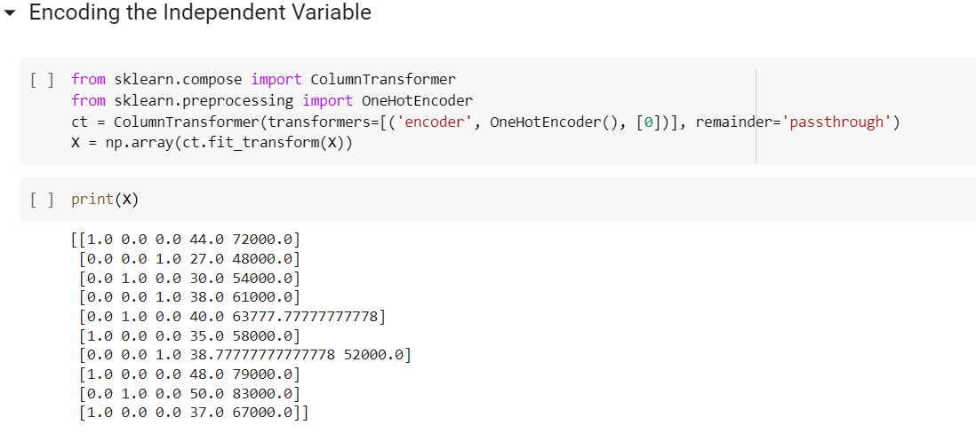

Slide 8
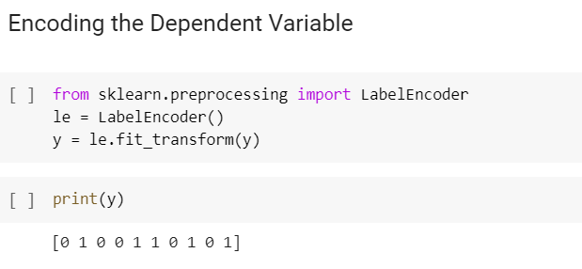
Label Encoder
Before
After

Slide 9
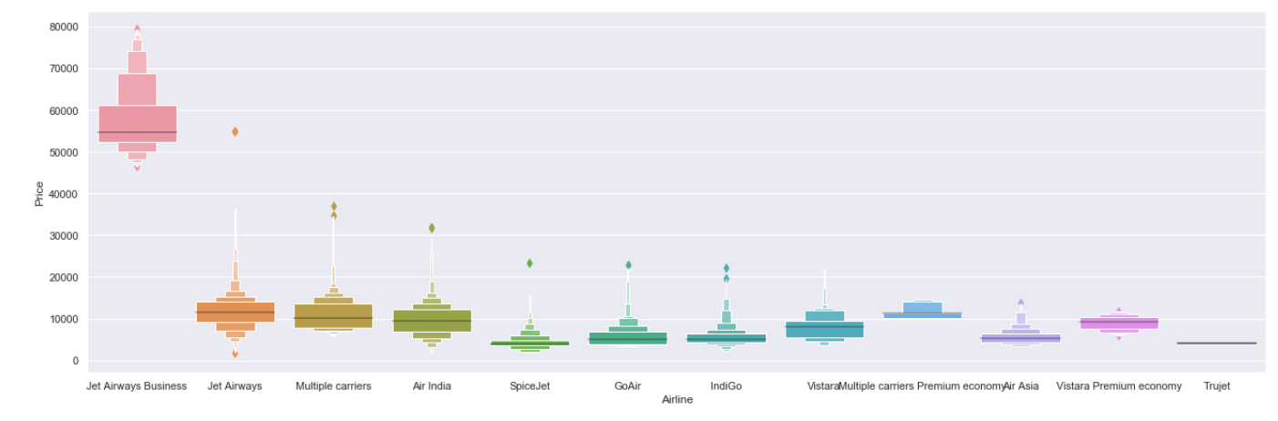
Price vs Airline

Slide 10
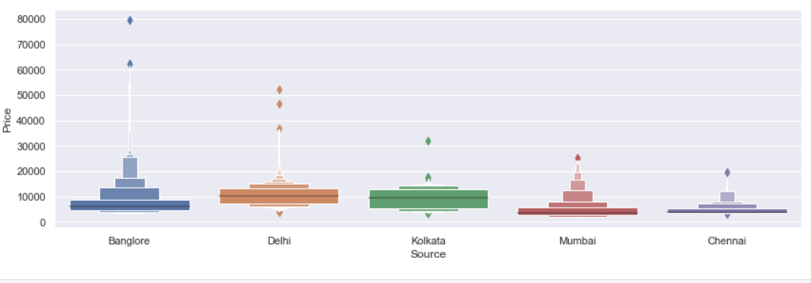
Price vs Source

Slide 11


